Slide 1
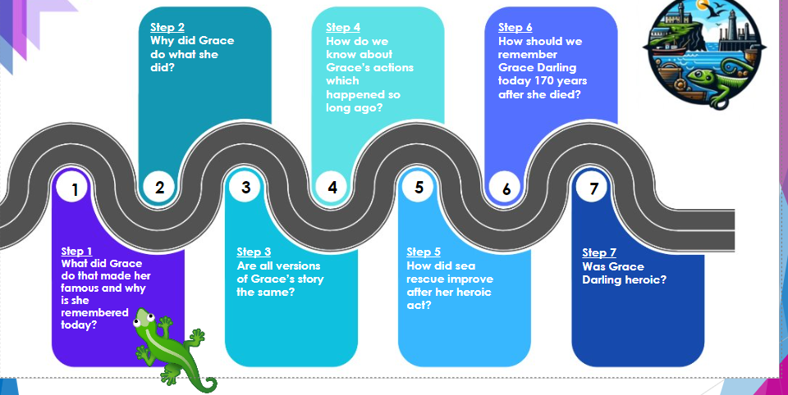
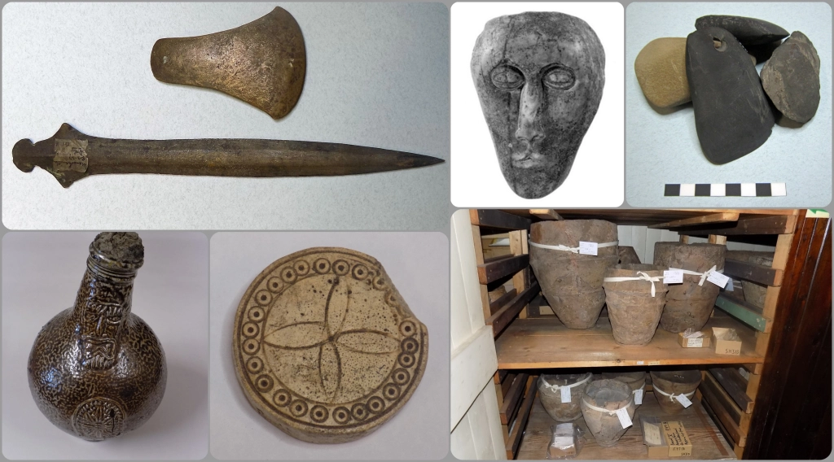
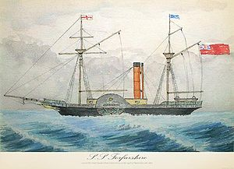
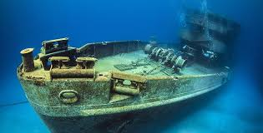
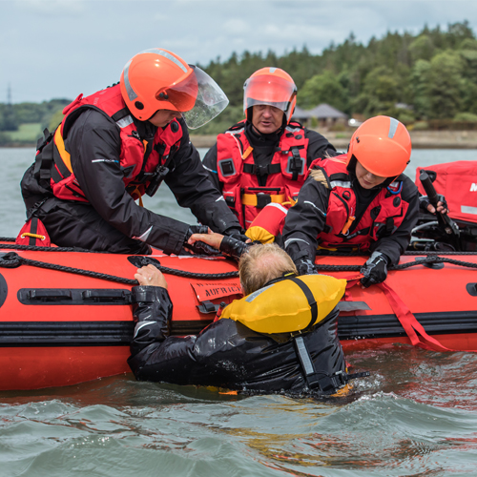
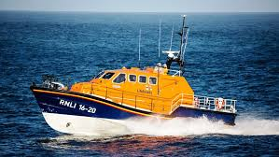
Was Grace Darling heroic?
Key vocabulary
Forfarshire-was a paddle steamer with brigantine rigging, built in Dundee in 1834.
Hero/heroine-one that shows great courage.
Memorial-something that keeps alive the memory of a person or event.
Rescue-to free from danger or evil.
RNLI-is the charity that saves lives at sea.
Survivor- to remain alive : continue to exist.
Wreck-the broken remains of something wrecked or ruined.
Famous​-much talked about : very well-known.
Artefact-is anything made, used, or modified by humans.
Key knowledge
1) Nearly 200 years ago, Grace carried out a very brave rescue when she was a young lady, saving 9 men’s lives. At that time it was unusual for women to be involved in such rescues.
2. People at the time thought Grace was a real heroine as she put her own life in real danger to save others she had never met.
3. She had to set out on a really stormy night in just a simple wooden boat with oars and amazingly managed to carry out the rescue, getting the men back safely to the lighthouse.
4. She inspired other young girls to acts of bravery and courage at a time when women were thought to be weak.
5. Newspapers quickly spread the news of her bravery and even Queen Victoria wrote to thank her.
6. As a result of her efforts, we now have much better ways of rescuing people at sea, for example the RNLI lifeboats
Artefact
Forfarshire
Wreck
RNLI
Rescue

